Slide 1
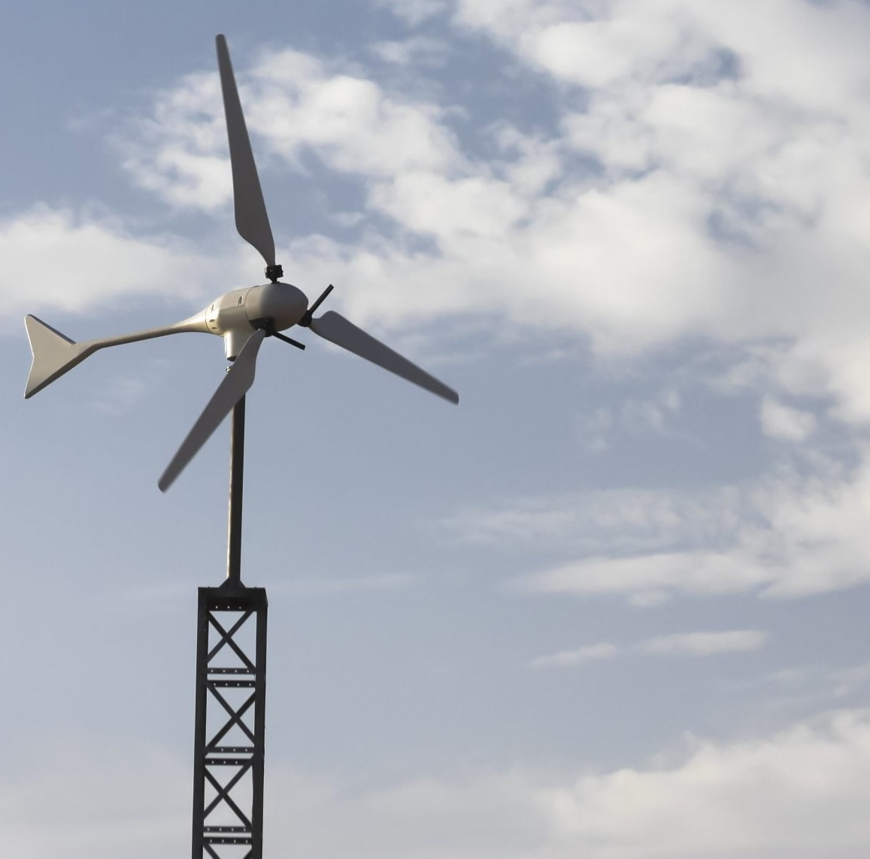

Team 7:
Wind-Powered Building
Team Members:
Colton, Reginald, Maxwell, Peter
Sponsor: Dr. Jang TA: Rohith Ramanujam Kumar
3rd Status Update
Notes:
https://www.ryse.energy/3kw-wind-turbines/#iLightbox[gallery_image_1]/11

Slide 2
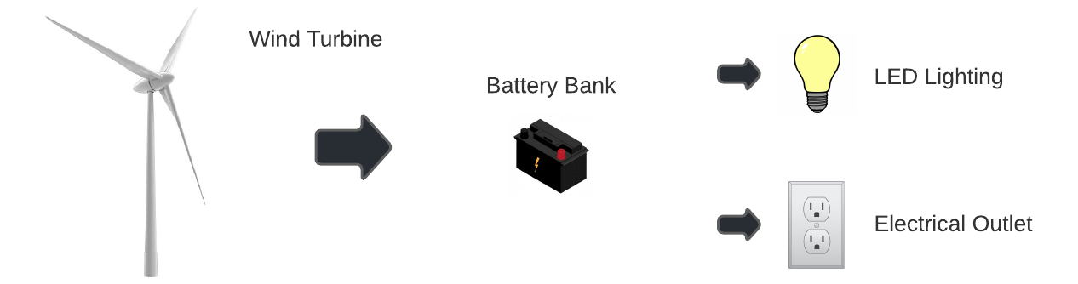
Project Summary
Implementing local renewable power generation to reduce reliance on fossil fuels
Using a wind turbine to capture energy, store it in batteries, and power AC and DC loads

Slide 3
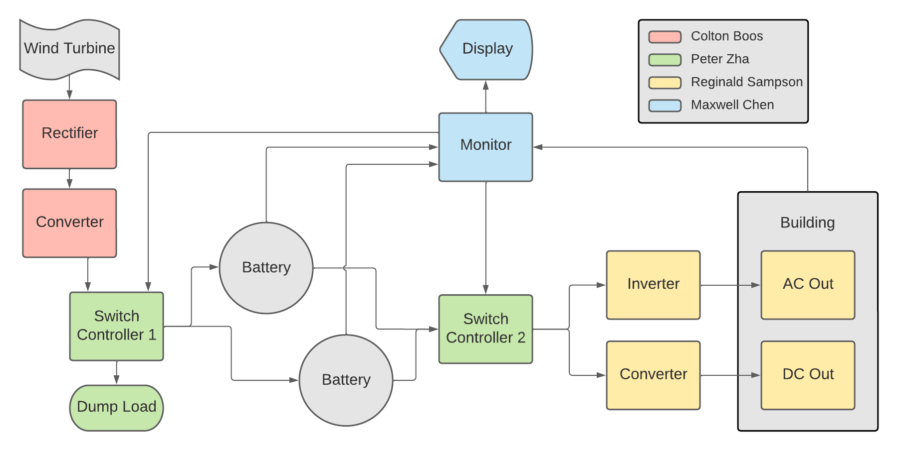
Block Diagram and Task Partition

Slide 4
Project Timeline
Early September
Late September
Early October
Late October
Early November
Mid November
Refine Subsystems
Begin Integration
Continue Integration
Continue Integration and Validation
Complete Validation
Final report and presentation
Ensure subsystems are in a working state and simulations are done.
Resolve any subsystem issues left over from the previous semester.
All subsystems should be in complete working order with PCBs on the way.
Begin integrating rectifier with boost converter.
All other PCBs should be ordered and ready to integrate.
Integrate Switch controllers with monitor subsystem.
Integration of Rectification and Conversion Subsystem with Switch Controller 1
Integration of Inversion and Conversion Subsystem with Switch Controller 2
Complete final report and prepare for final presentation.
Done
In Progress
Behind Schedule
Not Started

Slide 5
Rectification and Conversion Subsystem
Owner: Colton Boos
Accomplishments since last review 12 hours of effort | Ongoing progress/problems and plans until the next presentation
Completed testing of rectifier with AC input and measured DC output Completed testing of converter with 6.5V-30V input Completed integration of rectifier and converter | Integrate with switch controller 1 Implement wind-turbine outdoors and prepare for full system test

Slide 6
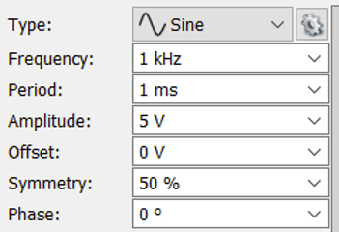
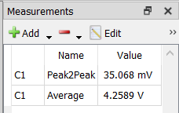
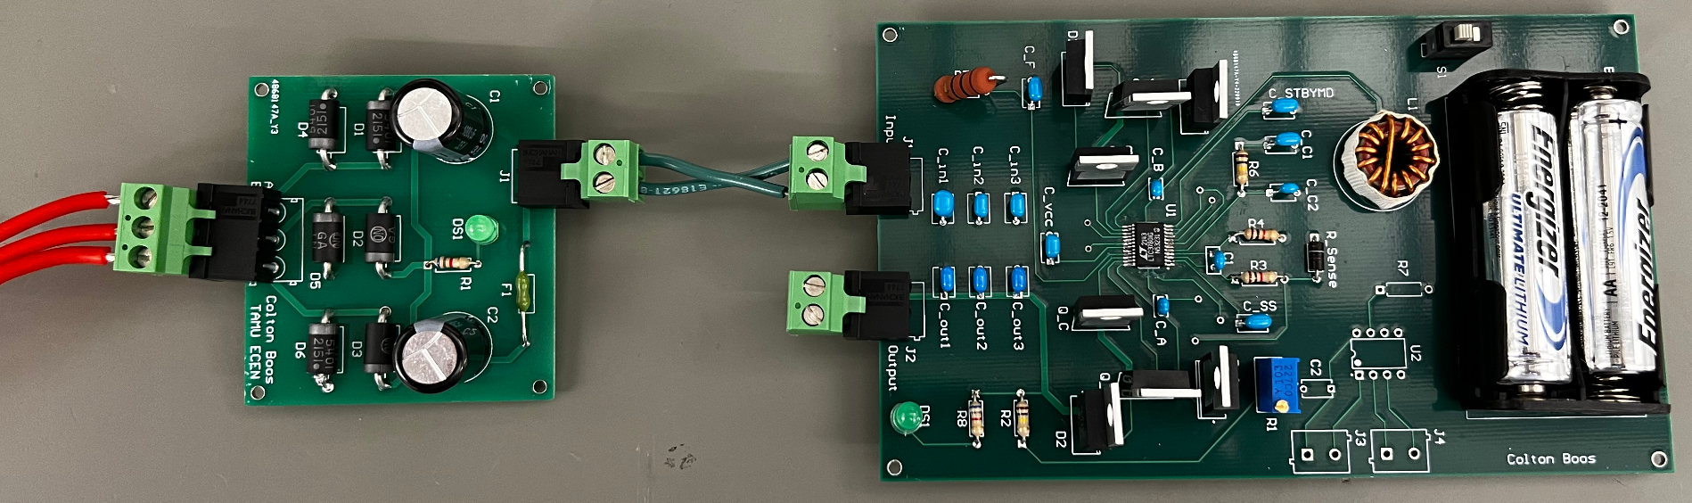
Rectification and Conversion Subsystem
Owner: Colton Boos
AC Sinusoidal Input
Measured DC Output
For Rectifier: One example of the AC-DC Conversion Test

Slide 7
Switch Controller Subsystem
Owner: Peter Zha
Accomplishments since last review 9 hours of effort | Ongoing progress/problems and plans until the next presentation
Breadboard tests with available components Brainstorming possible errors Began soldering components onto PCBs | PCBs arrived very late Test the switch Complete soldering of PCBs

Slide 8
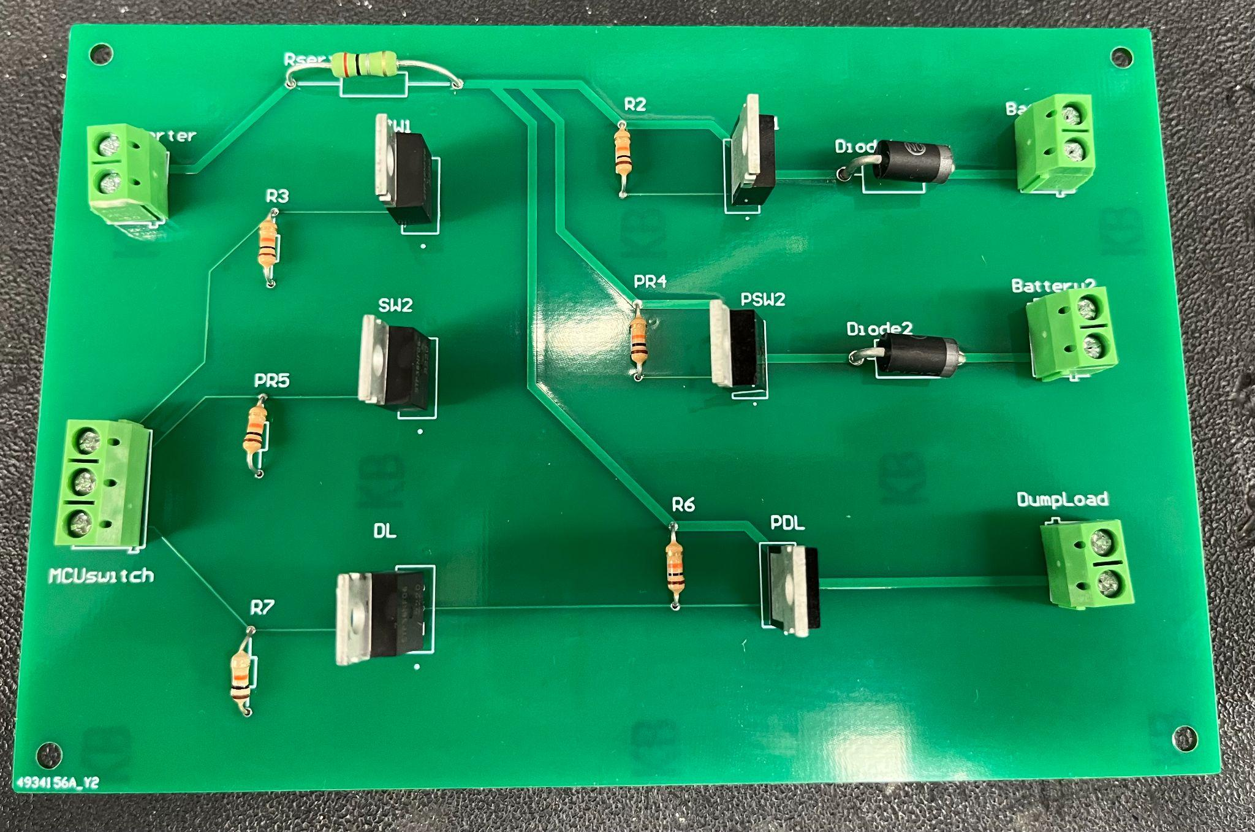
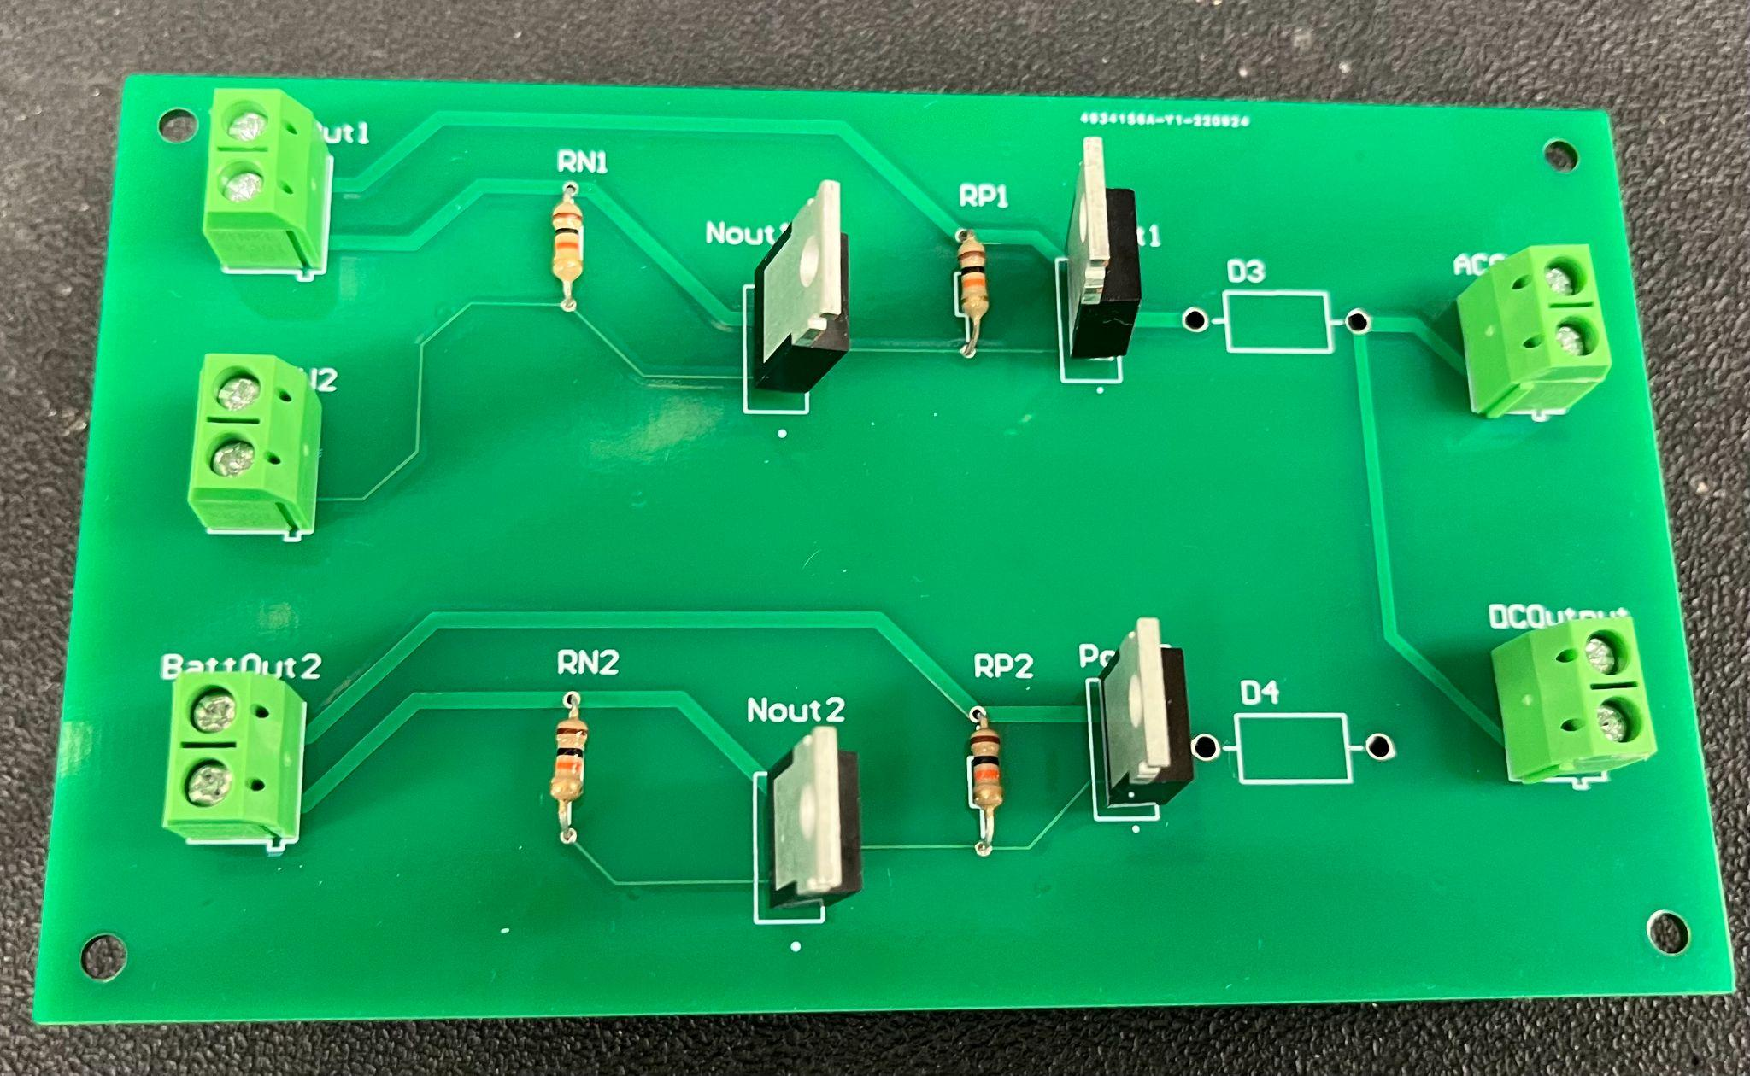
Switch Controller Subsystem
Owner: Peter Zha
Switch Controller 1
Switch Controller 2

Slide 9
Inversion and Conversion Subsystem
Owner: Reginald Sampson
Accomplishments since last review 10 hours of effort | Ongoing progress/problems and plans until the next presentation
Validated the inverter circuit with the transformer, load network and outlet connected Received converter, inverter and load network PCBs Finished soldering PCBs | Inductor leads don’t fit on PCB Test and validate PCBs Replace current transformer with new transformer

Slide 10
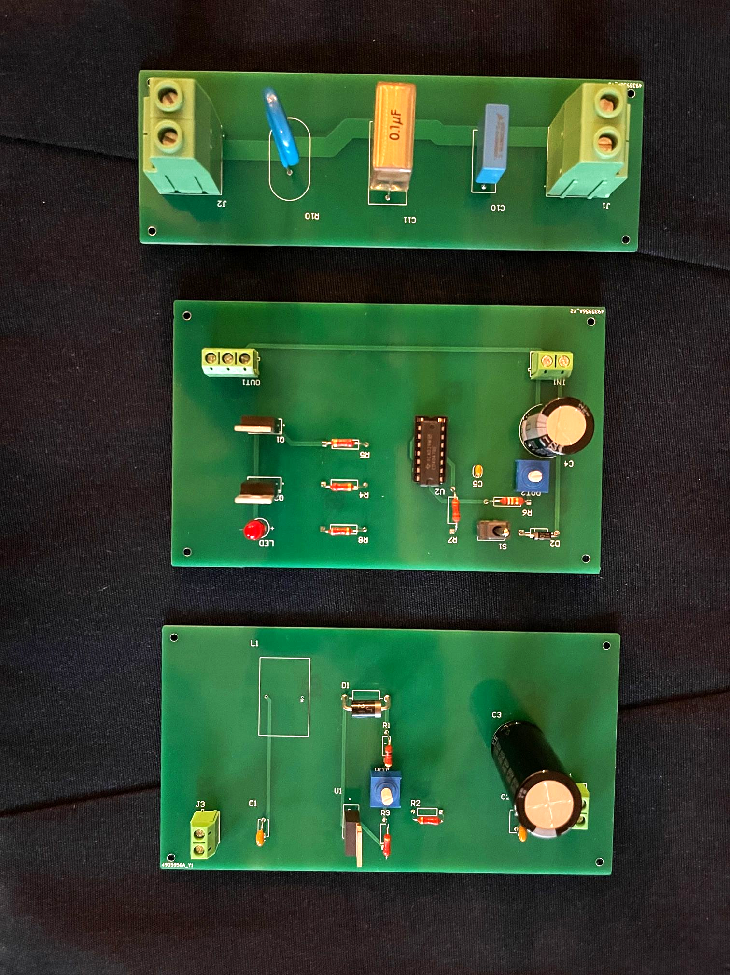
Inversion and Conversion Subsystem
Owner: Reginald Sampson
Converter
Inverter
Load Network

Slide 11
Monitor Subsystem
Owner: Maxwell Chen
Accomplishments since last review 15 hours of effort | Ongoing progress/problems and plans until the next presentation
Implemented new current and voltage sensors onto board Continued progress on code with testing on sensors | Shorted out microcontroller last week while testing Issues with sensor reading radically changing Further testing of sensors, finalization of code, and integration with Charge and Switch Controller Subsystem

Slide 12
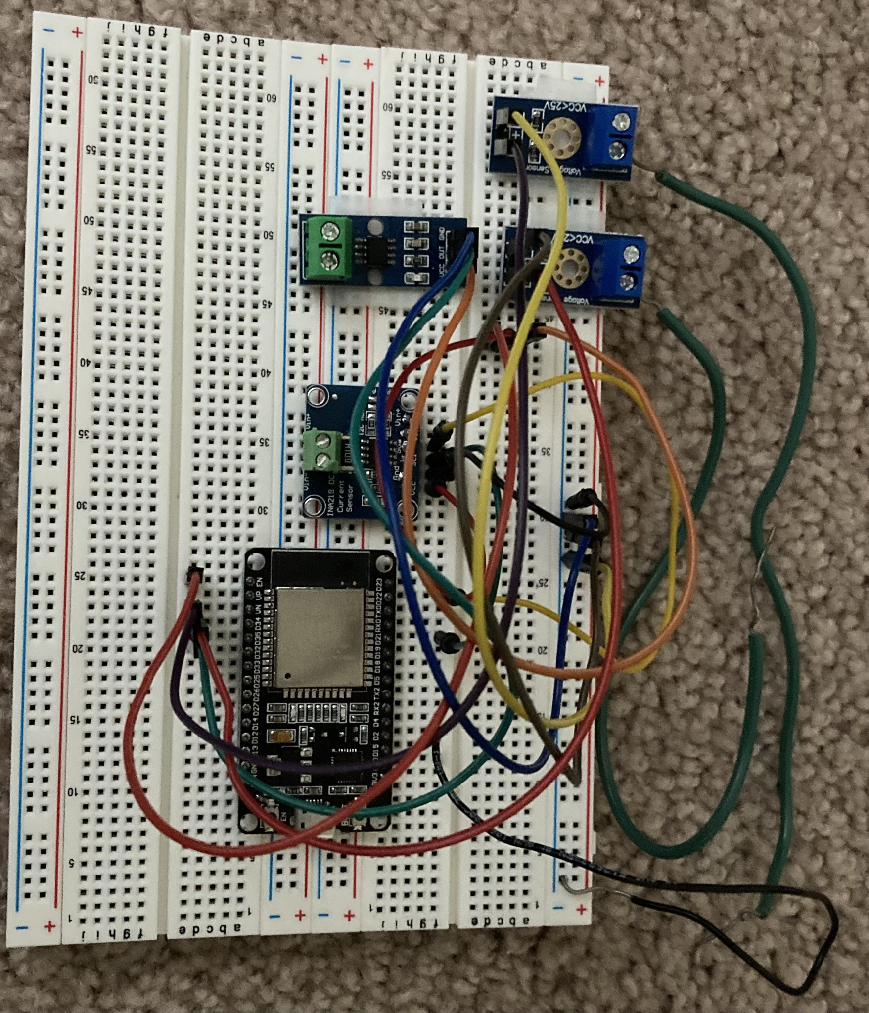
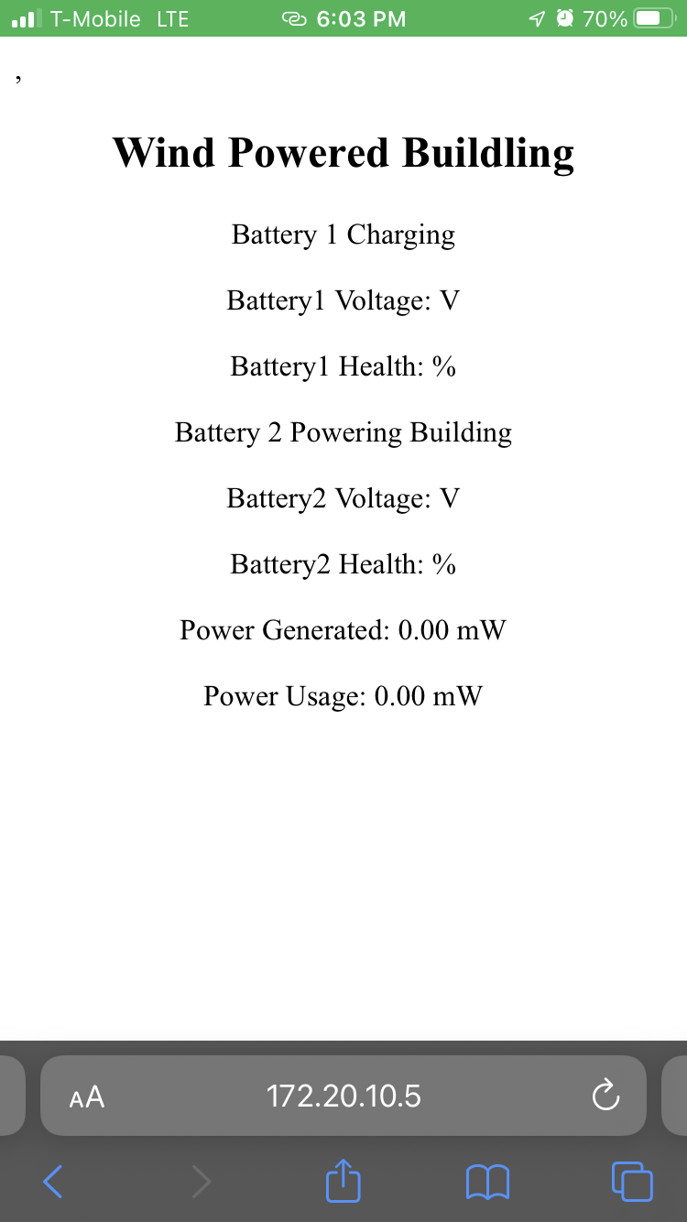
Monitor Subsystem
Owner: Maxwell Chen

Slide 13
Parts Ordering Status
Part Description | Status(Order Approved/ Order Placed/ Part Received
HiLetGo Voltage Sensor | Parts Received
INA219 Current Sensor | Parts Received
Power MOSFETs | Parts Received
Rectifier PCB | Parts Received
Converter (Colton) PCB | Parts Received
Inverter PCB | Parts Received
Converter (Reggie) PCB | Parts Received
Switch Controller PCBs | Parts Received

Slide 14
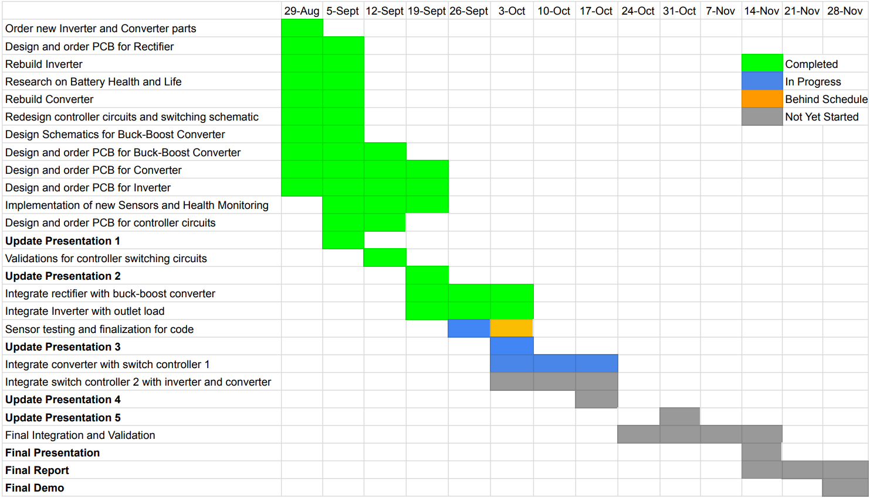
Execution Plan

Slide 15
Validation Plan
Responsible Engineer(s) | Test Name | Validation Requirements | Methodology | Status
Reggie | DC-AC Conversion Test | 12VDC is converted to 12VAC | Input DC voltage to the inverter and measure the output AC voltage before the transformer (with the transformer disconnected) | In Progress
Reggie | Transformer Step-up Test | Transformer output is 120VAC given 24VAC input | Input DC voltage to the inverter and measure the output AC voltage of the transformer using a digital multimeter | In Progress
Reggie | Inverter Output Test | Connected outlet outputs 120VAC and powers a load | Input DC voltage to the inverter and measure the output AC voltage of the transformer using a digital multimeter and plug in an iphone charger to the outlet | In Progress
Reggie | Converter with battery | Circuit elements function properly with battery voltage | Input DC voltage to the converter and measure the output DC voltage before the LEDs (with LEDs disconnected) | In Progress
Reggie | Converter Output | Converter output powers LED lights | Input DC voltage to the converter with the LEDs connected | In Progress
Colton | AC-DC Conversion Test | 2-20VAC is rectified to corresponding DC with < 0.1 V output ripple | Input 3 phase AC voltages and measure corresponding output | Completed
Colton | DC-DC Conversion Test | 6-20VDC is converted to set DC voltage | Input various DC voltages and measure corresponding output | Completed

Slide 16
Validation Plan
Responsible Engineer(s) | Test Name | Validation Requirements | Methodology | Status
Colton | Rectifier and Converter Connection Test | Voltage outputs to set DC voltage | Input 3 phase AC voltage to rectifier and measure output DC voltage of converter | Completed
Peter, Colton & Max | Charge Batteries Test | Wind-Power is correctly charging the battery bank with appropriate switching maneuvers | Use wind-turbine to output power, measure if battery capacity has gone up | Untested
Peter, Reggie & Max | Power Output Test | Battery bank is used to power the load with appropriate switching maneuvers | Measure voltage and current at output when switching battery outputs and determine if power transition is seamless | Untested
Peter | Input/Output Test | Correctly measures 13 V at output of switch | Measure voltage and current at the load of the switch and compare with expected current and voltage values | Untested
Peter | Switch Validation | The switch correctly switches between outputs | Input signals from microcontroller and test combination of expected inputs/outputs and verify with voltage and current measurements | In Progress
Maxwell | Battery Capacity Monitor | System is able to successfully track the capacity of the battery | Inputing a voltage and current source into the system or by testing with the actual batteries to see if it can accurately track how much charge is left | In Progress

Slide 17
Validation Plan
Responsible Engineer(s) | Test Name | Validation Requirements | Methodology | Status
Maxwell | Display Power Generated and Power Usage | System is able to display the power generated from the Wind Turbine, and the power used by the building | Similar to the battery capacity portion there needs to be a voltage and current source to test if this portion is working correctly. | In Progress
Maxwell | Display Battery Health | System will be able to calculate the battery health each battery and display this information to the user allowing them to know if they should replace the battery soon or not | Similar to the battery capacity portion there will need to be a current source to replicate the usage and flow of charge through a battery and seeing if it is able to accurately calculate the health of said battery. | In Progress
Maxwell | Website for System Monitoring | Website is accessible and cleanly displays information about the entire system | Once other parts of the systems are setup the website should be able to correctly display information to the user | In Progress
Maxwell | Output Signal for Switch Controller | System will have triggers for specific cases of when each battery should be used or charged. | Once connected with the charge and switch controller check that the system is correctly outputting signals to the controller and that the controller is performing the correct result | Untested
Full Team | Full System Test | Wind-Power is used to charge the battery bank, Monitor sends signals to switching circuits, switch controller outputs correct path, battery power is used by inverter and converter to power the load | Charging: Input power from wind turbine and signals from MCU, then measure and compare voltage and current. Discharging: Power laptop charger and phone charger, verify with voltage and current measurements | Untested

Slide 18
Thank you for listening
Any Questions?
Notes:
https://www.ryse.energy/3kw-wind-turbines/#iLightbox[gallery_image_1]/11

